Slide 1

www.robustmakine.com

Slide 2
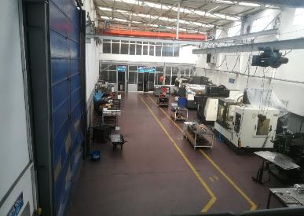
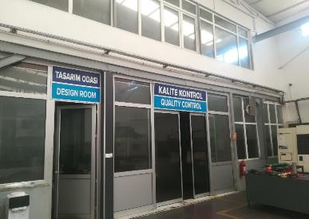
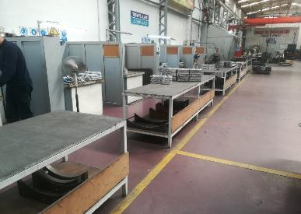
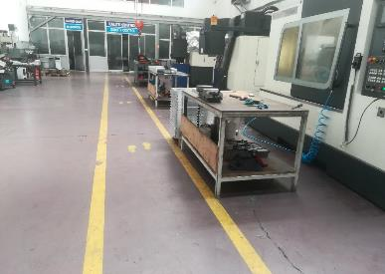
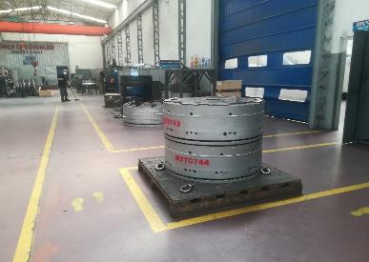
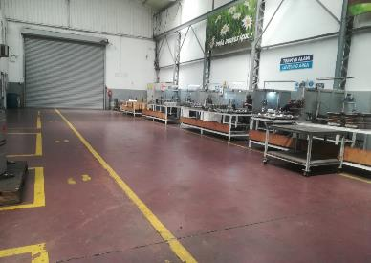
BİZ KİMİZ?
Robust Makine ve Kalıp A.Ş. Türk Otomotiv ve lastik sektörünün merkezi Kocaeli'de yaklaşık 20 yıl önce kurulmuş olup, 1600 m2'lik tesisinde 33 personel ile faaliyetlerine devam etmektedir.
Odak noktamız lastik sektörünün pişirme kalıplarının bakım ve imalatı ile Otomotiv ve Savunma Sanayi sektörünün her türlü yedek parça ve özel proje-fikstür ihtiyacını karşılayacak imalatlardır.

Slide 3
WHO WE ARE?
Robust Machine and Mold A.Ş. was established in Kocaeli, the center of the Turkish Automotive and tire industry, approximately 20 years ago and continues its activities in with 33 personnel in its 1600 m2 plant.
Our focus is on the maintenance and manufacturing of curing molds of the tire industry and manufacturing to meet all kinds of spare parts and special Project-Fixtures needs of the Automotive and Defense Industry sector.

Slide 4
MACHINE PARK
CNC CENTERS SPECIFICATIONS
CNC VERTICAL TURNING CENTER, YOU JI, YV1200ATC MAX SWING DIA 1600MM
CNC HORIZONTAL LATHE, HWACHEON RPM 5000– X:850 – Ø650
CNC MACHINING CENTER, HWACHEON RPM 8000 – X:1100, Y:600, Z:600
CNC MACHINING CENTER, MORI SEIKI RPM 12000– X:1000, Y:500, Z:500
CNC MACHINING CENTER, HARTFORD RPM 12000– X:1020, Y:600, Z:600
CNC MACHINING CENTER, 4 AXIS , YCM-NXV1680A RPM 12000– X:1630, Y:762, Z:700
UNIVERSAL LATHES
UNIVERSAL FACE LATHE MAX TURNING LENGTH 1500 – Ø2400
UNIVERSAL LATHE 1 MAX TURNING LENGTH 1500 – Ø1110
UNIVERSAL LATHE 2 MAX TURNING LENGTH 1000 – Ø520
UNIVERSAL LATHE 3 MAX TURNING LENGTH 3000 – Ø660
UNIVERSAL LATHE 4 MAX TURNING LENGTH 4000 – Ø800

Slide 5
MACHINE PARK
UNIVERSAL MILLING MACHINES SPECIFICATION
MILLING MACHINE 1 X900,Y350,Z600
MILLING MACHINE 2 X900,Y350,Z600
MILLING MACHINE 3 X1200,Y500,Z600
OTHERS
SANDBLASTING MACHINE Ø 1200 CAPACITY
SANDBLASTING MACHINE Ø 700 CAPACITY
MANUEL PANTOGRAPH ENGRAVING STATION
BAND SAWING MACHINE
HYDRAULIC PRESS FORCE 180 TF
WIRE EROSION MACHINE X800, Y1000, Z800
ELECTRO EROSION MACHINE X450, Y250, Z300
CNC MILLING ROUTER 1 X400, Y400, Z150
CNC MILLING ROUTER 2 X400, Y600, Z200

Slide 6



















OUR REFERENCES

Slide 7
THANK YOU
Contact Number: +90 (262) 349 20 54 – 0 (532) 066 59 54
Adress: Karadenizliler, Ordulu Cd. No:80, 41140 Başiskele/Kocaeli
Web: www.robustmakine.com

