Slide 1






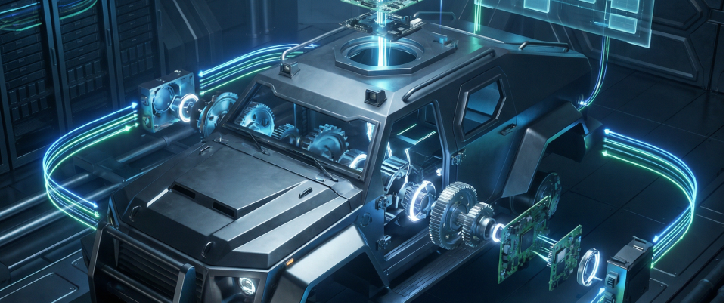
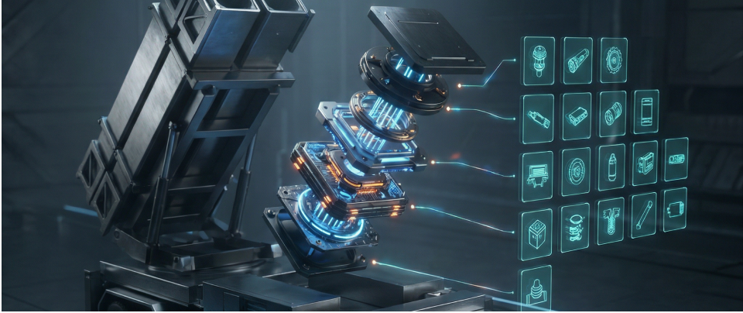



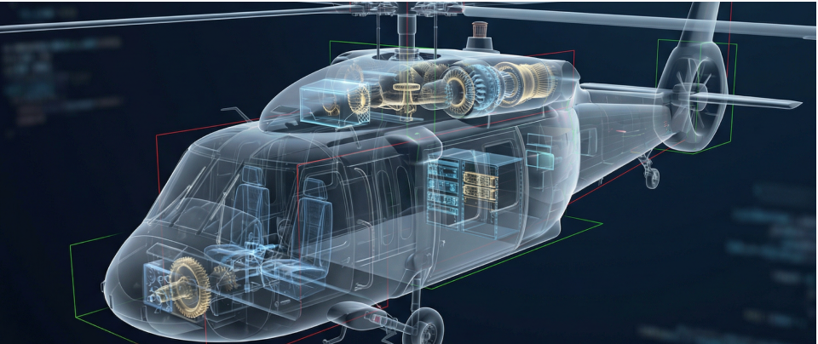
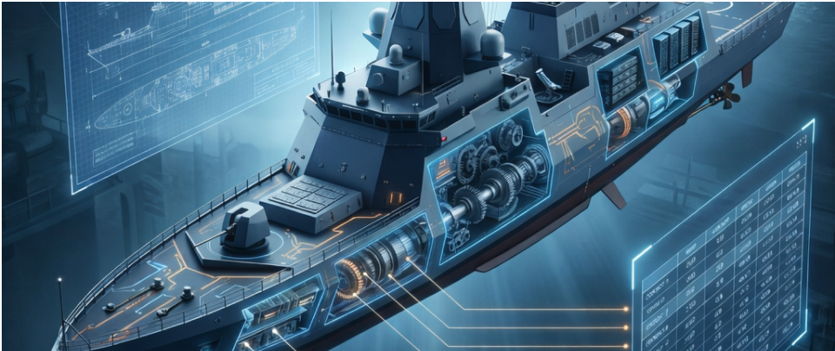


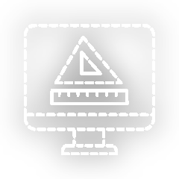

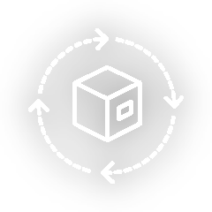
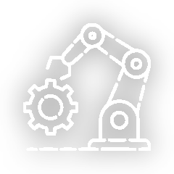









Who Are We ?
Mezoit Teknoloji Mühendislik ve Bilişim A.Ş. is an Ankara-based technology and engineering company. With its experienced team of expert engineers across various industries, it delivers innovative solutions in CAx, PLM, and DM, effectively leading digital transformation initiatives.
Mezoit AutoXpert is a comprehensive engineering software focused on CAD, PLM, and DM processes, offering multi-platform support. Operating within a unified environment, it aims to reduce errors, enhance quality, and lower costs across design, manufacturing, and operational processes.
CAD
Our Services
As Mezoit Teknoloji, we deliver comprehensive solutions in engineering, software development, and system integration. Through CAx, PLM, DM, and CM consulting, along with custom system designs, we strengthen your digital infrastructure and enhance operational efficiency.
As Mezoit Teknoloji, we are the official partner of Dassault Systèmes in Türkiye. Through the 3DEXPERIENCE Platform and its brands; CATIA, ENOVIA, SIMULIA, and DELMIA, we guide our customers in their digital transformation journeys, supporting efficiency and innovation at every stage from design to manufacturing.
PLM
DM
info@mezoit.com
www.mezoit.com
+90 312 385 55 30
OSTİM Teknopark

